Slide 2
What is Design Patterns
In software engineering, a design pattern is a general repeatable solution to a commonly occurring problem in software design.
It is a description or template for how to solve a problem that can be used in many different situations.
Design patterns can speed up the development process by providing tested, proven development paradigms.
In addition, patterns allow developers to communicate using well-known, well-understood names for software interactions. Common design patterns can be improved over time, making them more robust than ad-hoc designs.

Slide 3
Design patterns are organized into Creational, Structural, or Behavioral purpose.
Creational patterns concern the process of object creation.
Structural patterns deal with the composition of classes or objects.
Behavioral patterns characterize the ways in which classes or objects interact and distribute responsibility.

Slide 4
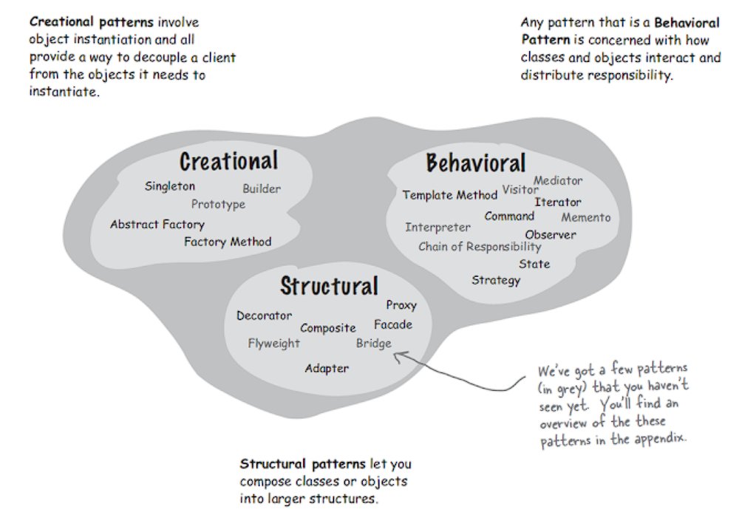

Slide 5
Creational design patterns
Creational patterns involve object instantiation and all provide a way to decouple a client from the objects it needs to instantiate. This pattern can be further divided into class-creation patterns and object-creational patterns.

Slide 6
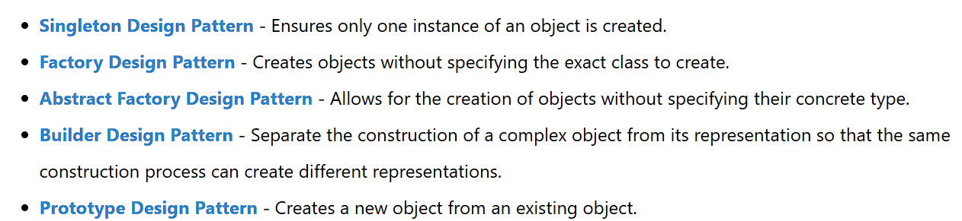

Slide 7
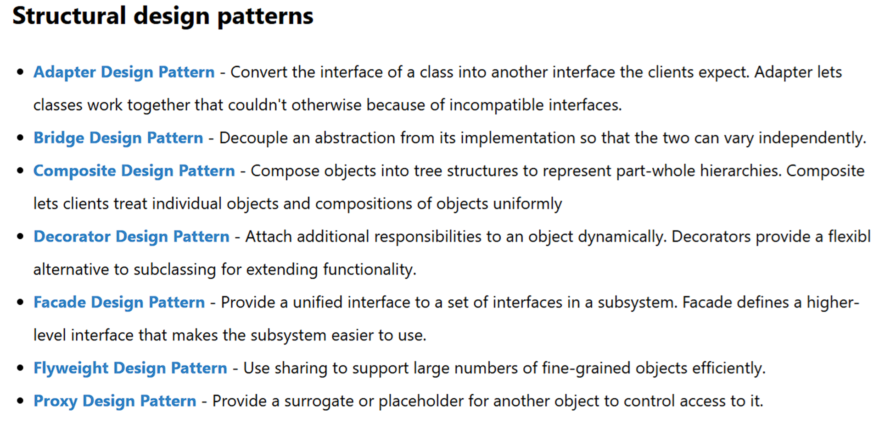

Slide 8
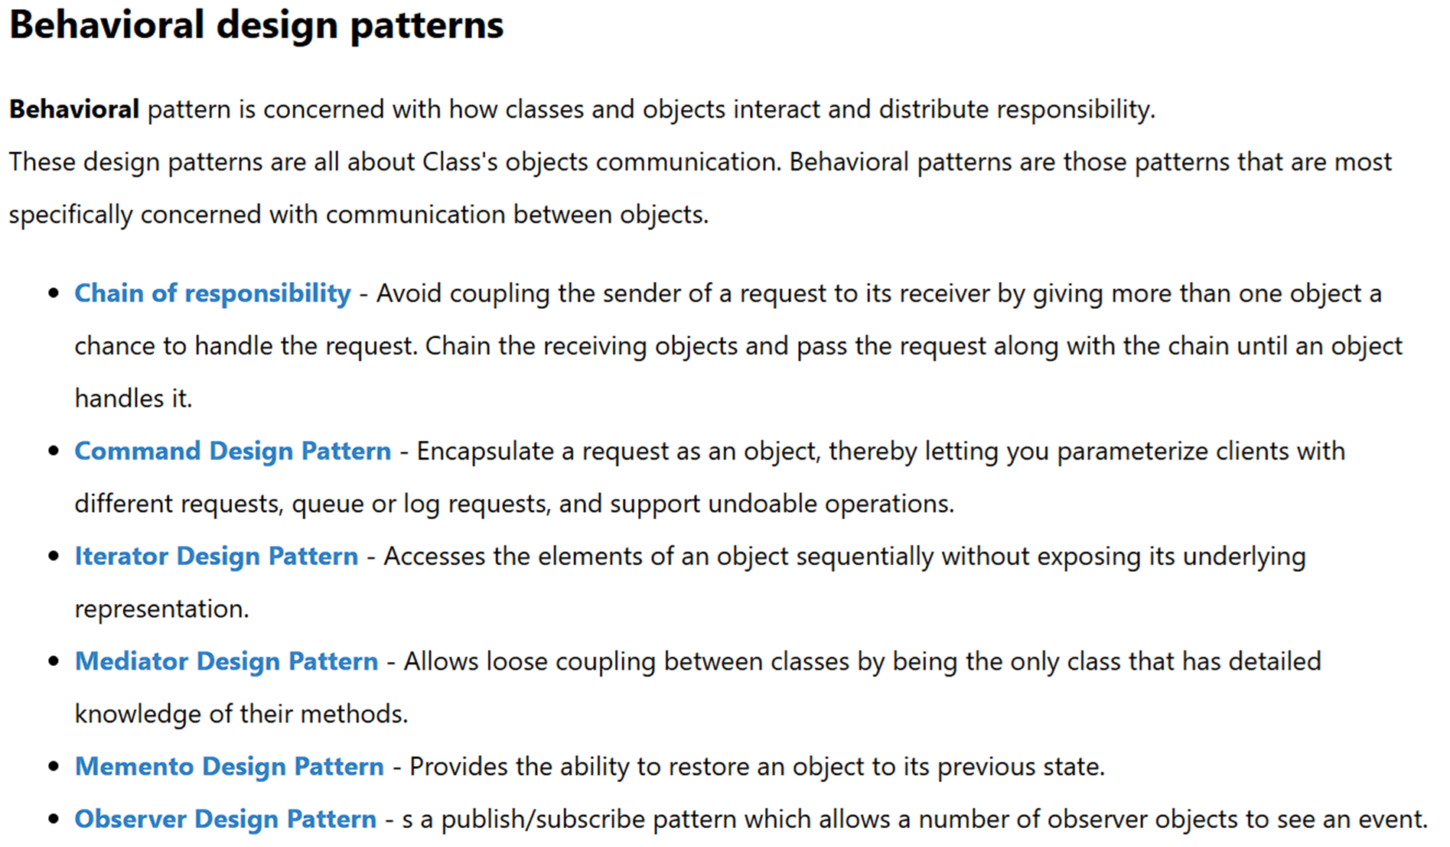

Slide 9
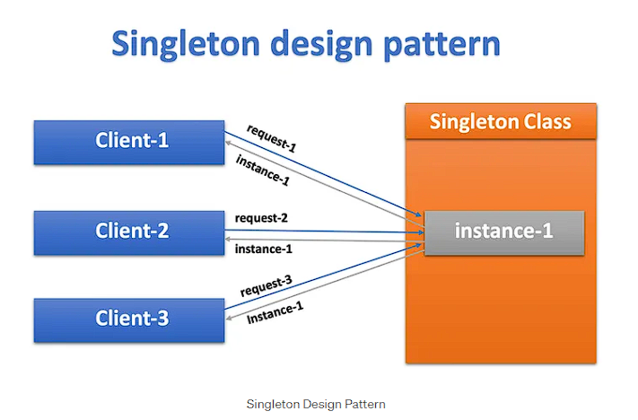
Singleton Design Pattern
The Singleton Design Pattern ensures that a class has only one instance and provides a global point of access to that instance.
It is designed to restrict the instantiation of a class to a single "unique" instance.

Slide 10
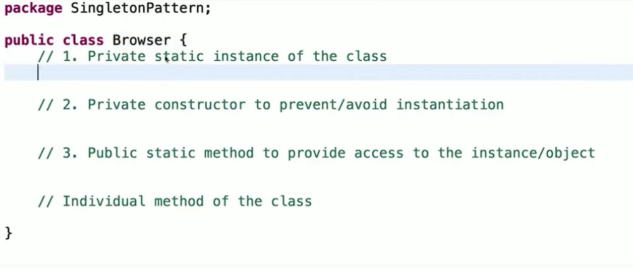

Slide 11
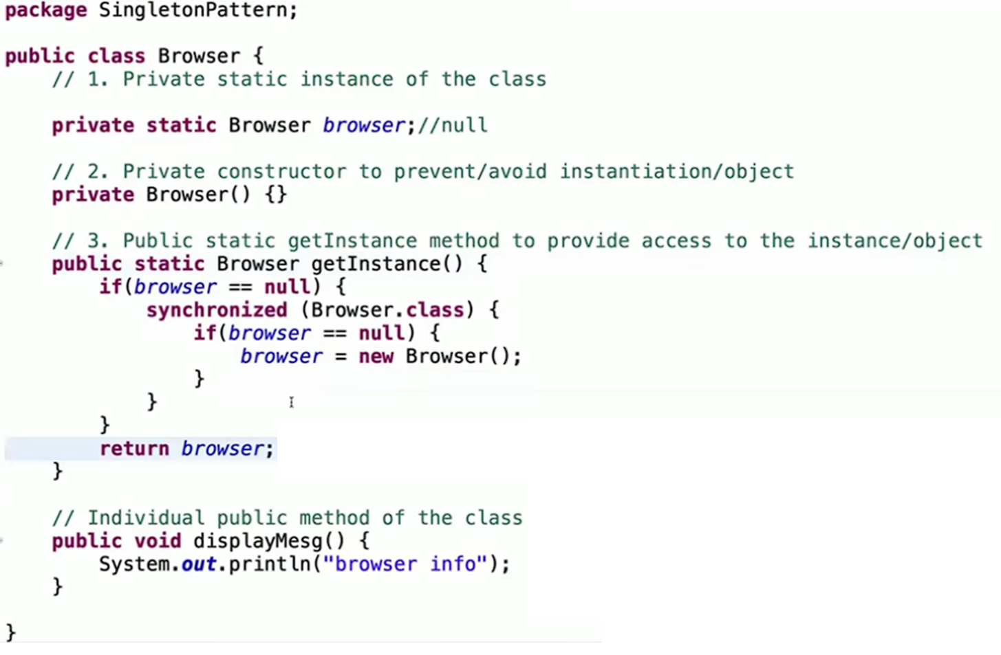

Slide 12
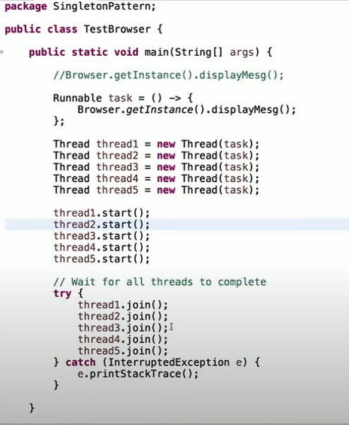

Slide 13
Factory Design Pattern
The Factory Design Pattern is a creational design pattern that provides an interface for creating objects but allows subclasses to alter the type of objects that will be created. Instead of calling a constructor directly, a factory method is used to create the desired object, abstracting the object creation process.
Real-World Use Cases
1. GUI libraries where each operating system provides a different implementation of a button or a window.
2. E-commerce platforms offer multiple payment gateways, where each gateway has a different process.
3. Database connection pools where connections to different types of databases need to be created based on configuration.
Implementation Steps
1. Define a common interface or abstract class for the product.
2. Implement different concrete classes of the product.
3. Create a factory class that has a method to return an instance of the product based on a given input.

Slide 14
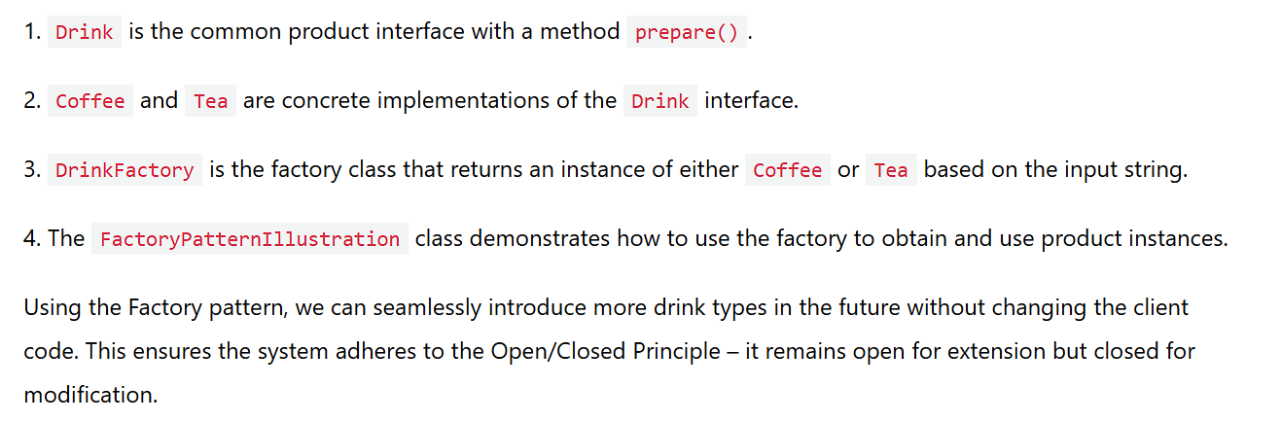

Slide 15
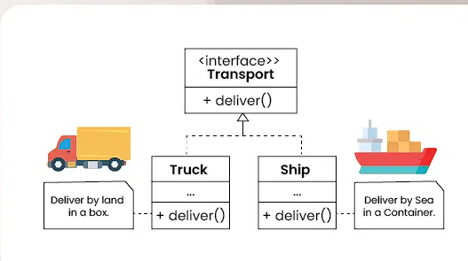

Slide 16
Builder Design Pattern
The Builder Design Pattern is a creational pattern that provides a clear and flexible way to construct complex objects by separating the construction process from the actual representation of the object. It allows for step-by-step construction of an object, and gives control over its initialization.
Implementation Steps
1. Create a specific builder interface/abstract class defining the steps to construct the object.
2. Implement the builder to construct the object, step-by-step.
3. Define a director class that takes a builder as a parameter and constructs the object.
4. The client then uses the director with the specific builder to get the desired object.

Slide 17
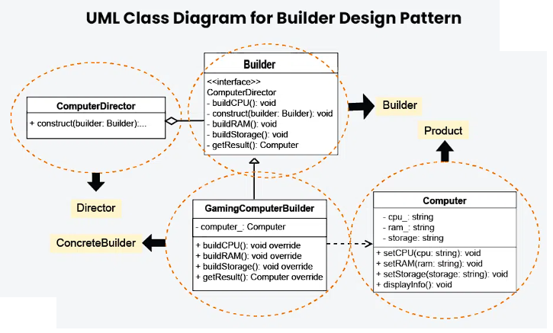

Slide 18
Prototype Design Pattern
The Prototype Design Pattern falls under the category of creational patterns and involves creating objects by copying an existing object, known as the prototype.
The Prototype pattern allows cloning or copying of an already existing object instead of creating new ones.
Real-World Use Cases
1. Cloning/copying configurations or settings for different modules in software.
2. Creating unique instances of objects that have most of their state consistent but differ slightly.
3. In gaming, duplicating existing game objects or characters.
Implementation Steps
1. Create a prototype interface that declares a method for cloning itself.
2. Implement the prototype interface in concrete classes that require cloneable behavior.
3. Use the clone method to duplicate objects.

Slide 19
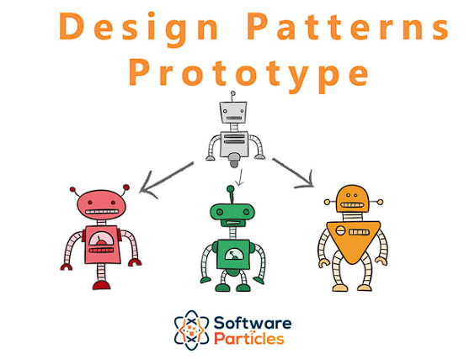

Slide 20
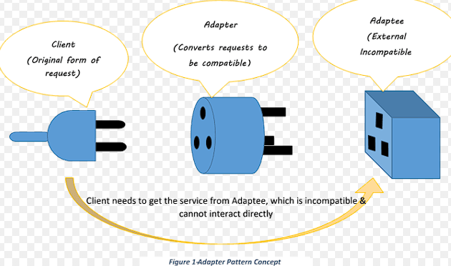
Adapter Design Pattern
The Adapter Design Pattern is a structural pattern that allows objects with incompatible interfaces to collaborate.
It acts as a bridge between two incompatible interfaces by converting the interface of one class into an interface expected by the client.

Slide 21
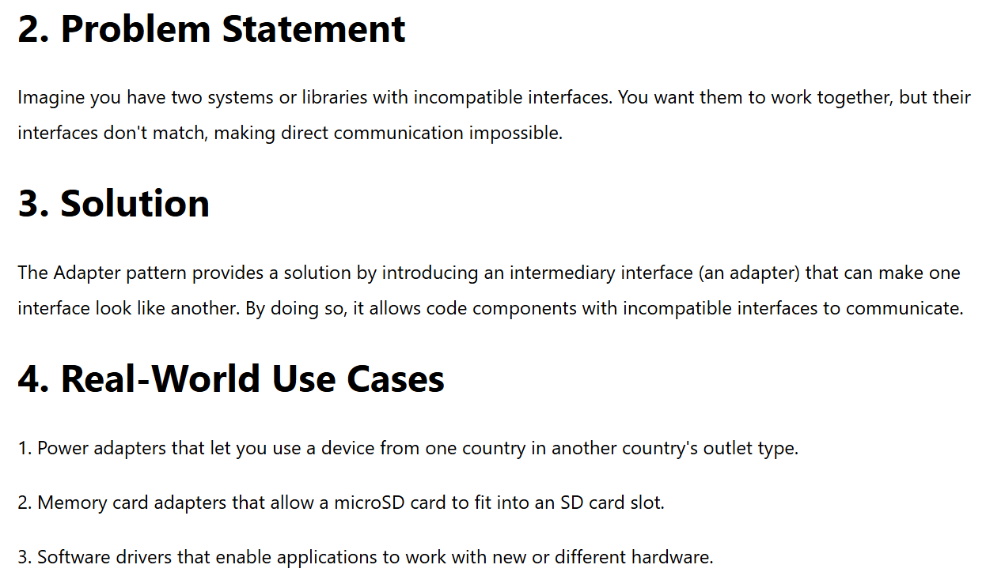

Slide 22
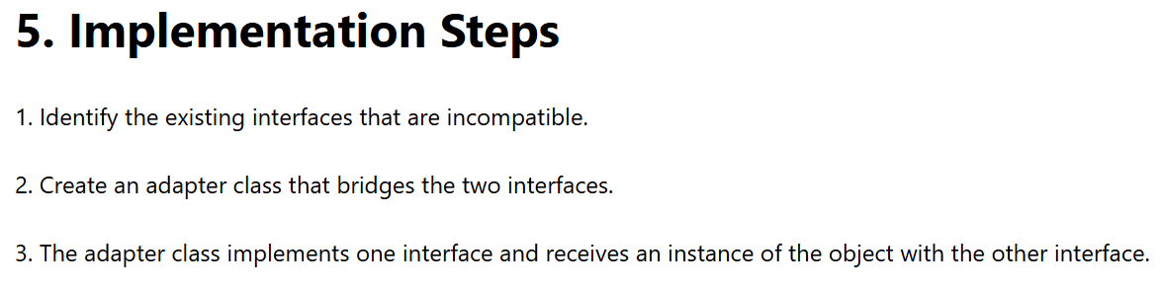

Slide 23
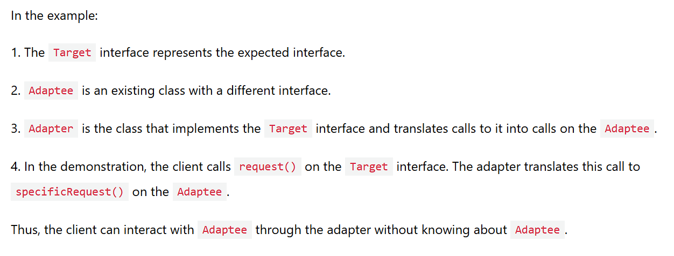

Slide 24
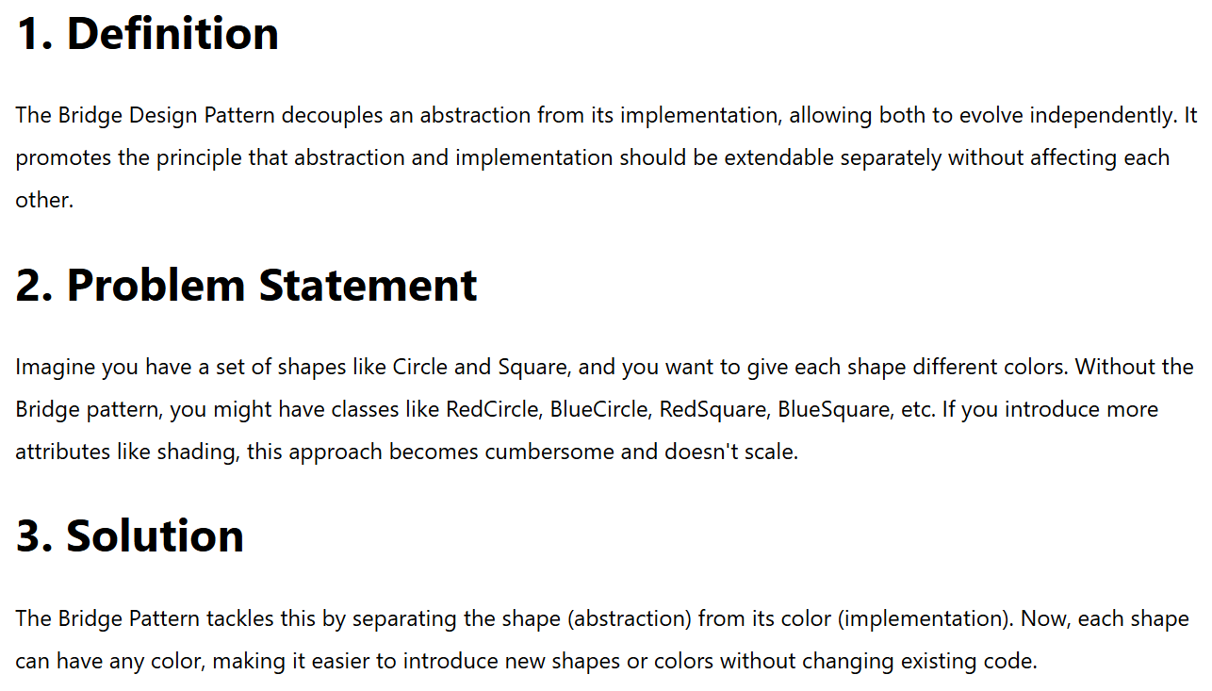
Bridge Design Pattern

Slide 25
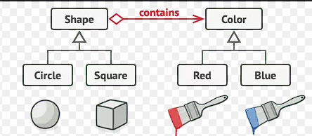

Slide 26
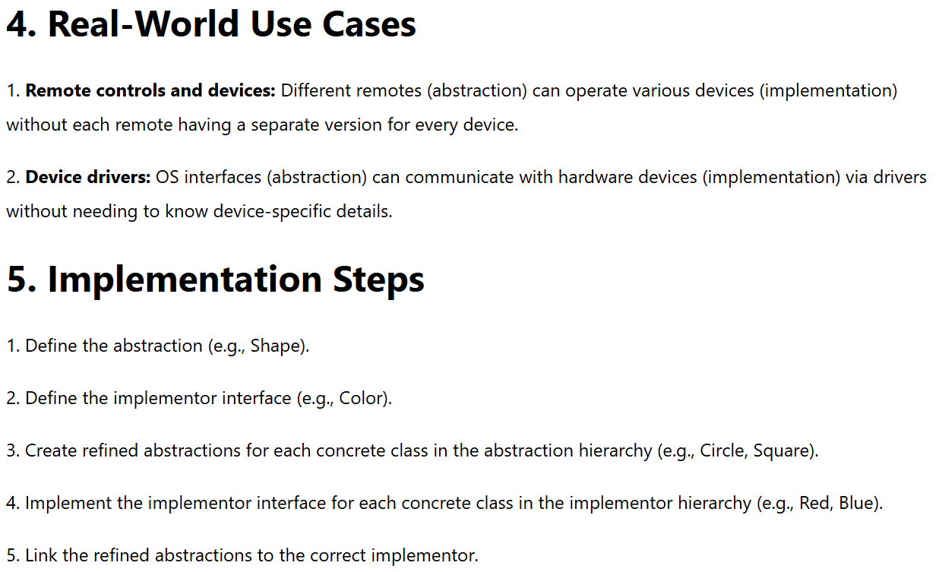

Slide 27
Explanation
The Bridge Pattern separates the Circle and Square (shapes) from their colors (Red and Blue).
Each shape can independently vary from its color.
By introducing this separation, it becomes easier to add new shapes or colors without modifying the existing hierarchies.

Slide 28
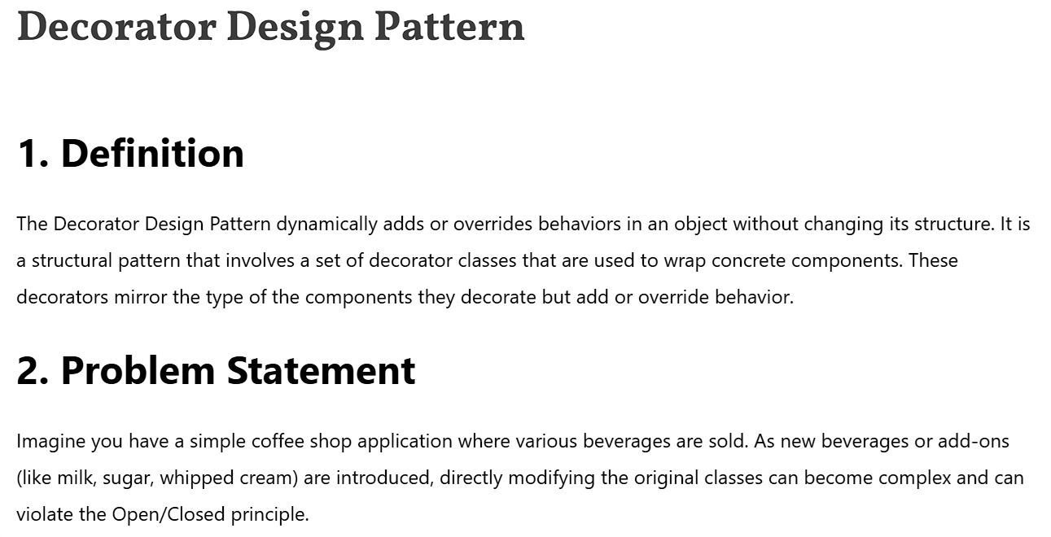

Slide 29
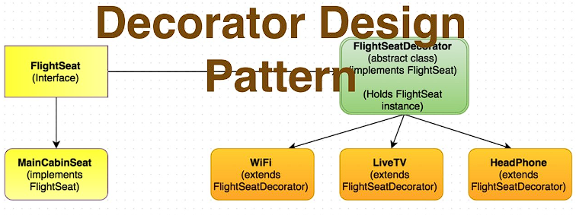

Slide 30
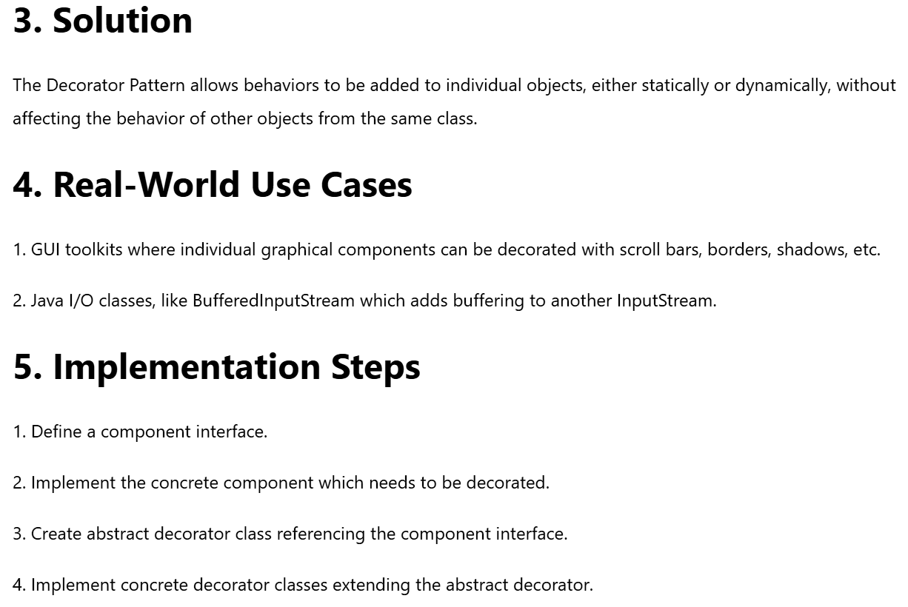

Slide 31
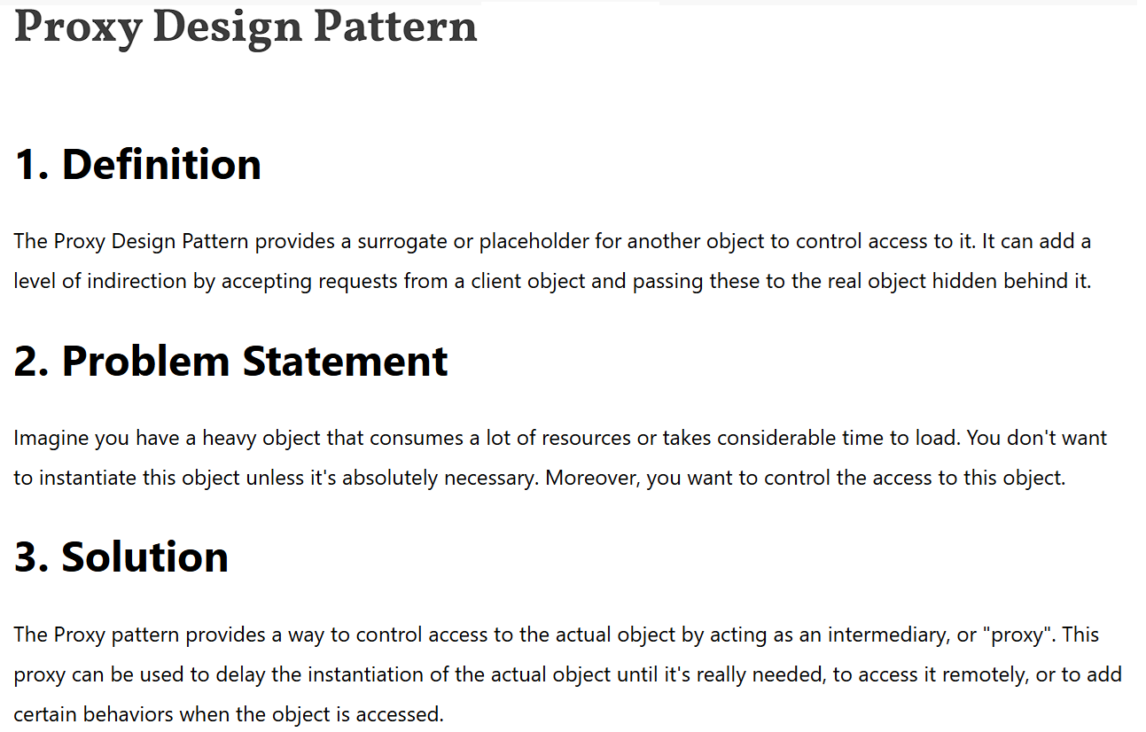

Slide 32
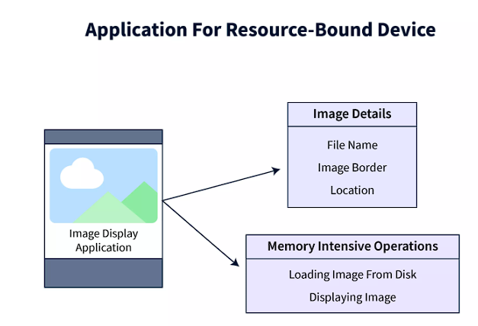

Slide 33
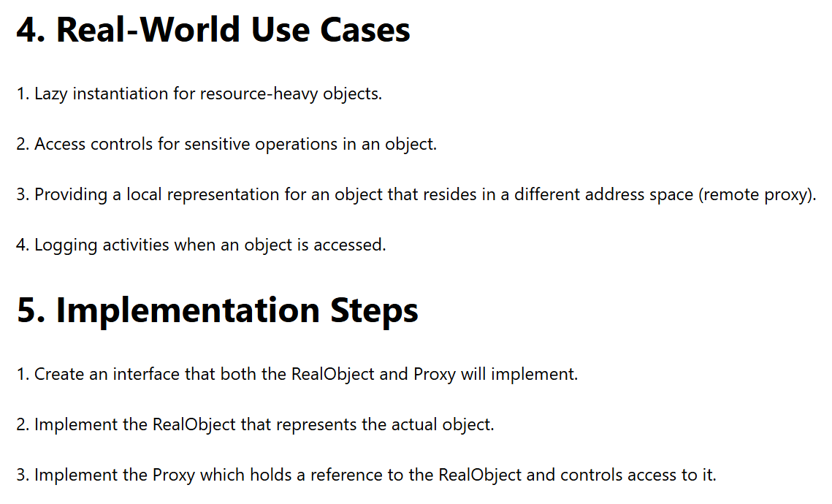

Slide 34
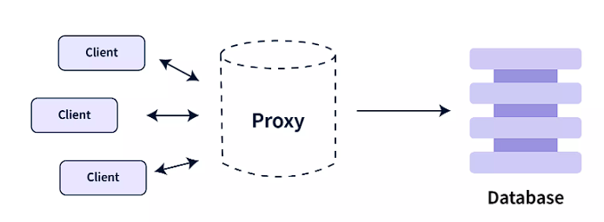

Slide 35
What is Searching?
In computer science, searching is the process of finding an item with specified properties from a collection of items. The items may be stored as records in a database, simple data elements in arrays, text in files, nodes in trees, vertices and edges in graphs, or they may be elements of other search spaces.
Why do we need Searching?
Searching is one of the core computer science algorithms. We know that today’s computers store a lot of information. To retrieve this information proficiently we need very efficient search algorithms.
There are certain ways of organizing the data that improve the searching process. That means, if we keep the data in proper order, it is easy to search for the required element. Sorting is one of the techniques for making the elements ordered.

Slide 36
Binary Search with Example
Binary search is a fast search algorithm with run-time complexity of Ο(log n). This search algorithm works on the principle of divide and conquer. For this algorithm to work properly, the data collection should be in the sorted form.
Let us consider the problem of searching for a word in a dictionary. Typically, we directly go to some approximate page [say, middle page] and start searching from that point. If the name that we are searching for is the same then the search is complete. If the page is before the selected pages then apply the same process for the first half; otherwise, apply the same process to the second half. Binary search also works in the same way. The algorithm applying such a strategy is referred to as a binary search algorithm.

Slide 37
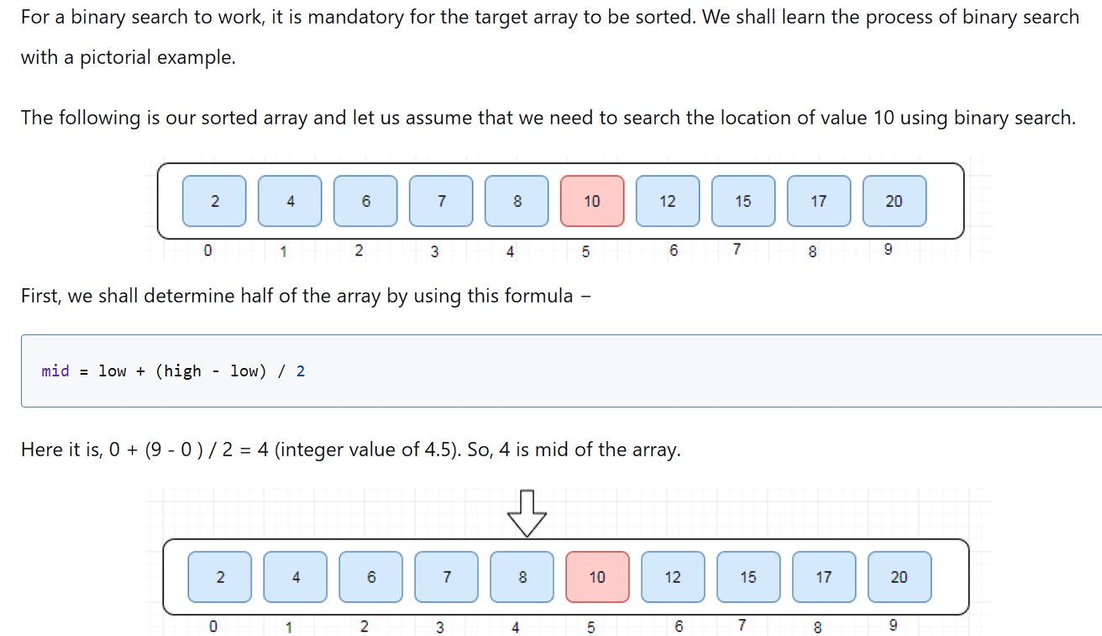

Slide 38
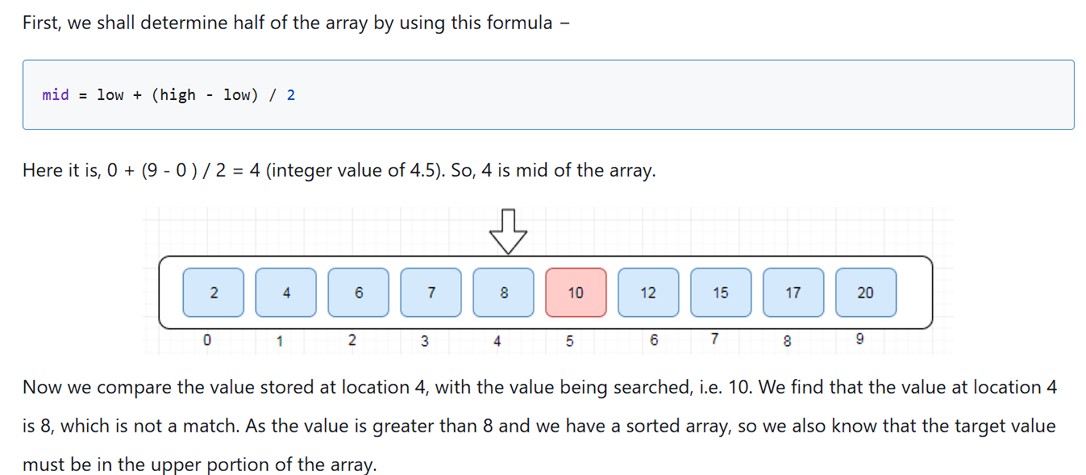

Slide 39
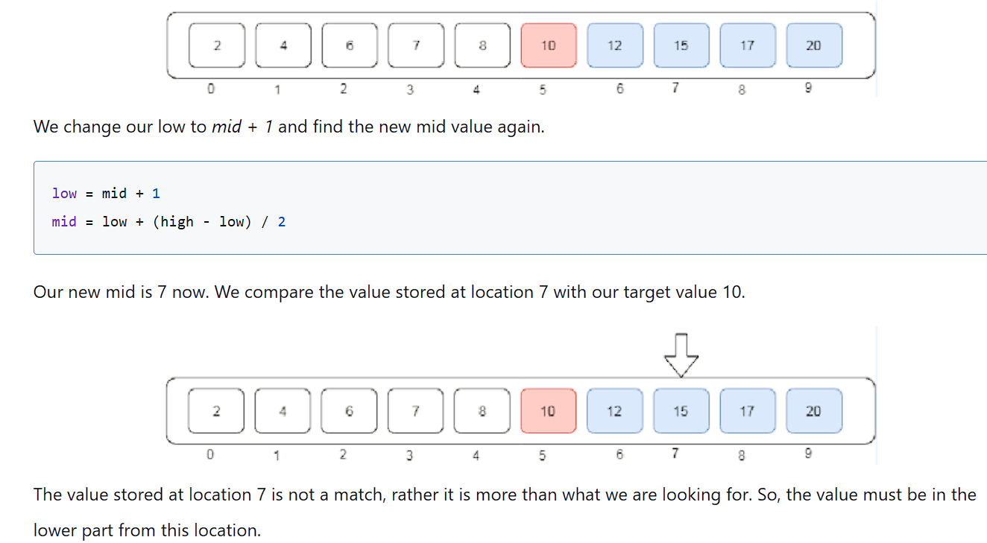

Slide 40
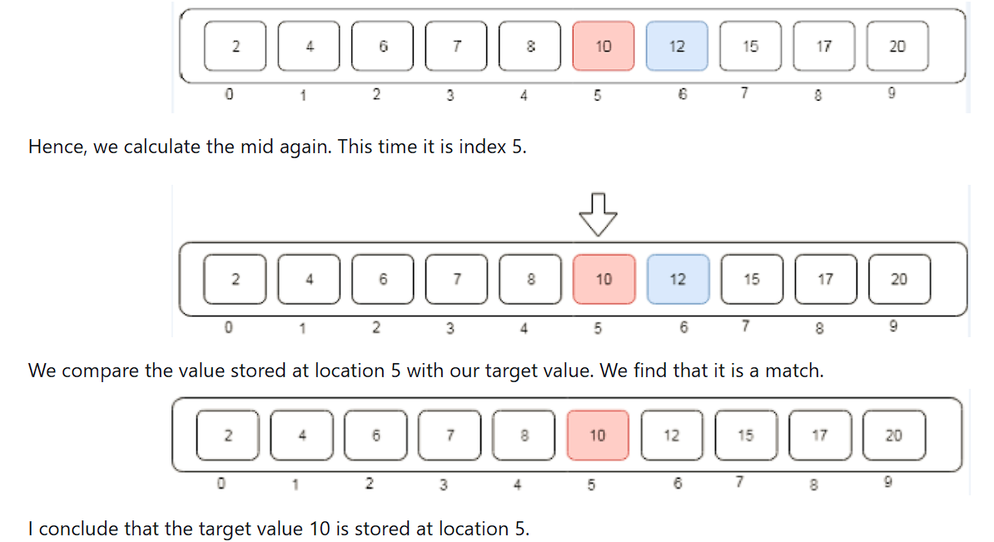

Slide 41
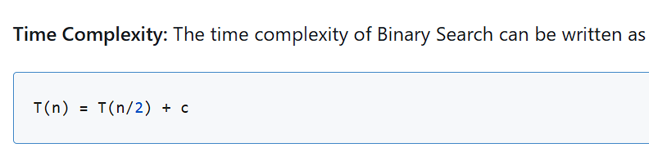
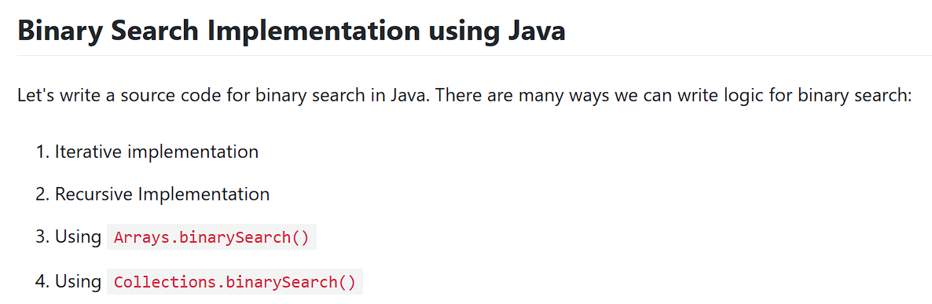

Slide 42
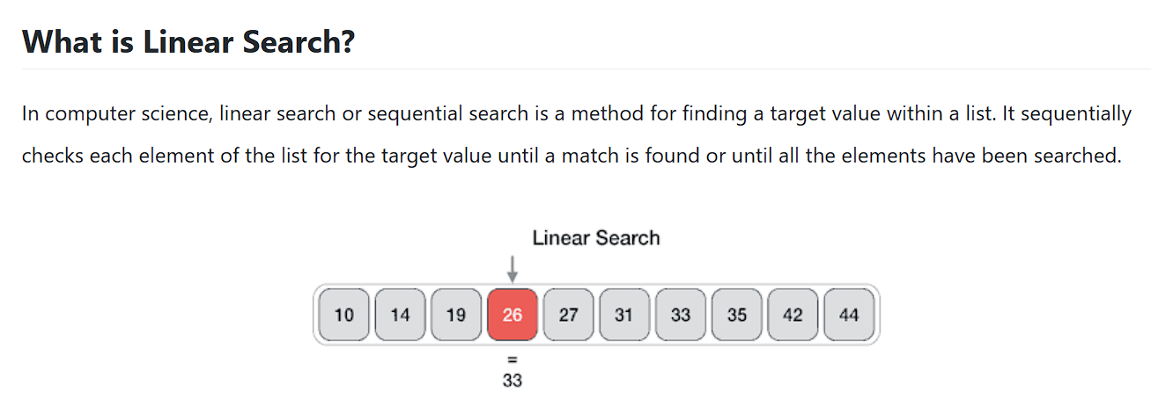

Slide 43
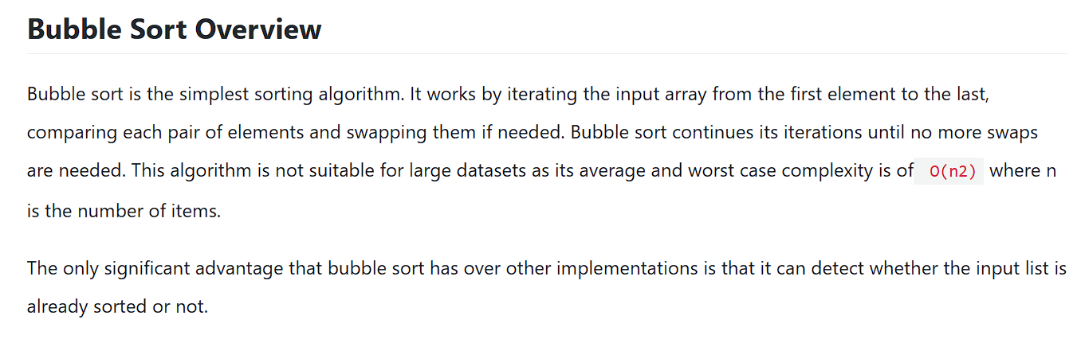

Slide 44
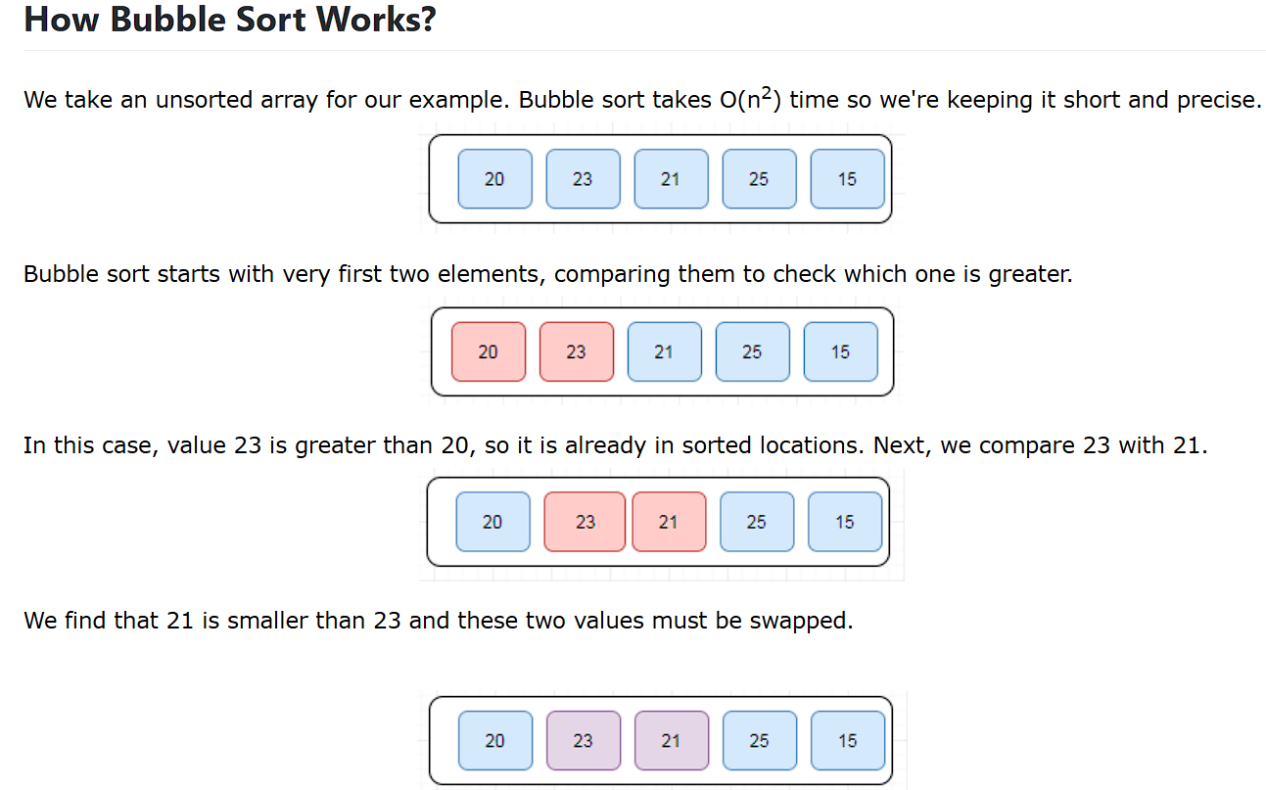

Slide 45
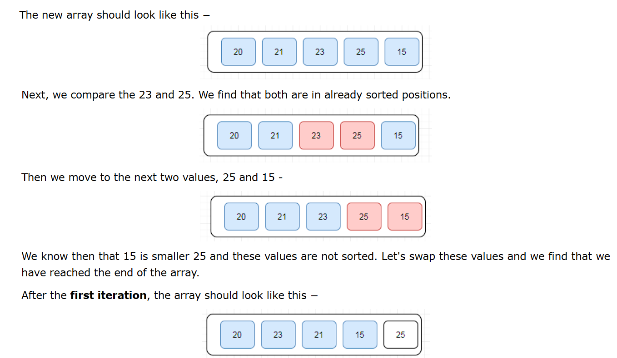

Slide 46
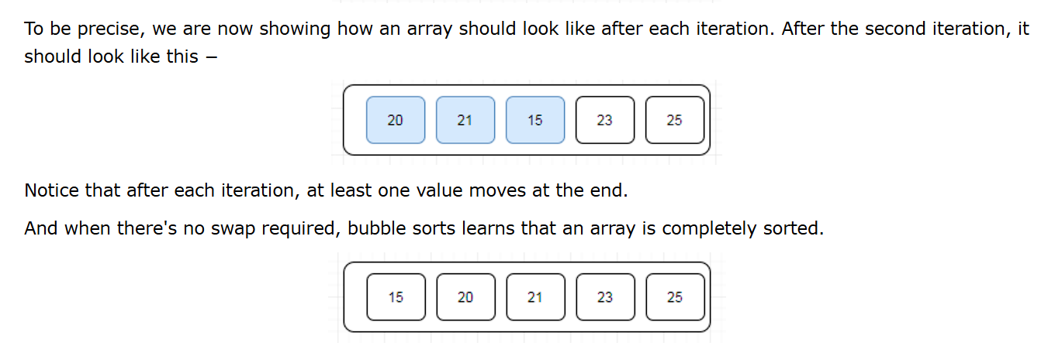

Slide 47
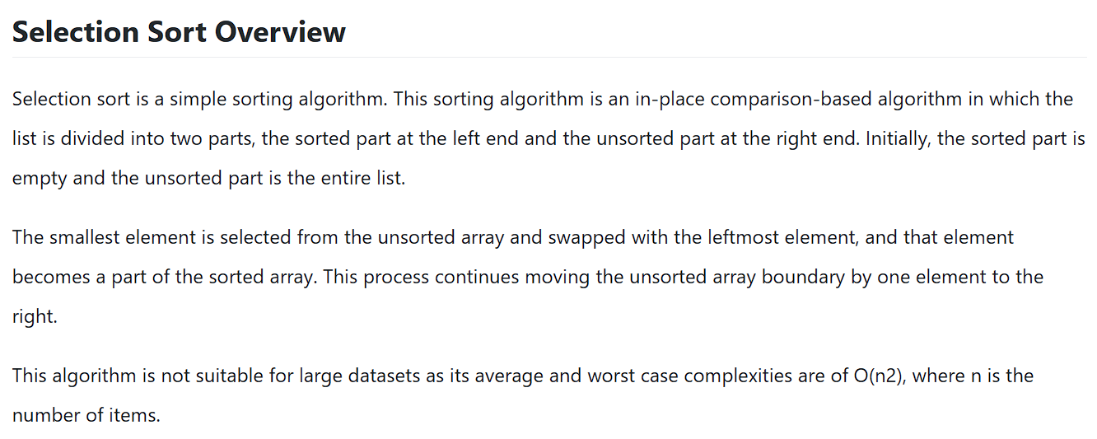

Slide 48
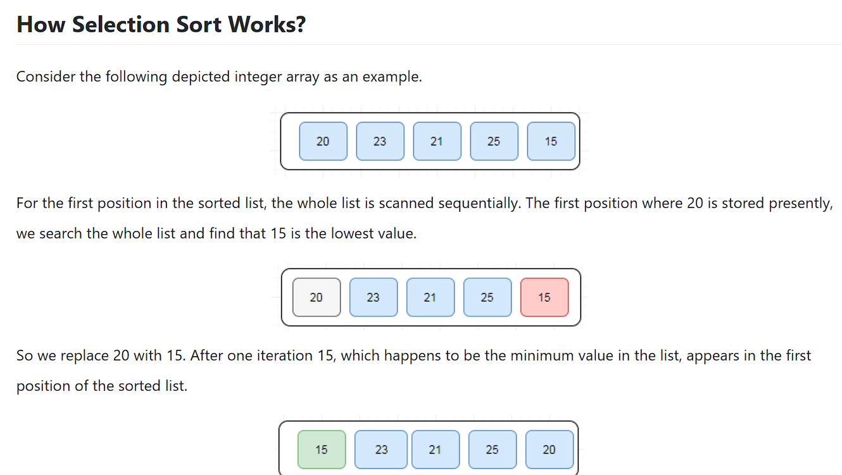

Slide 49
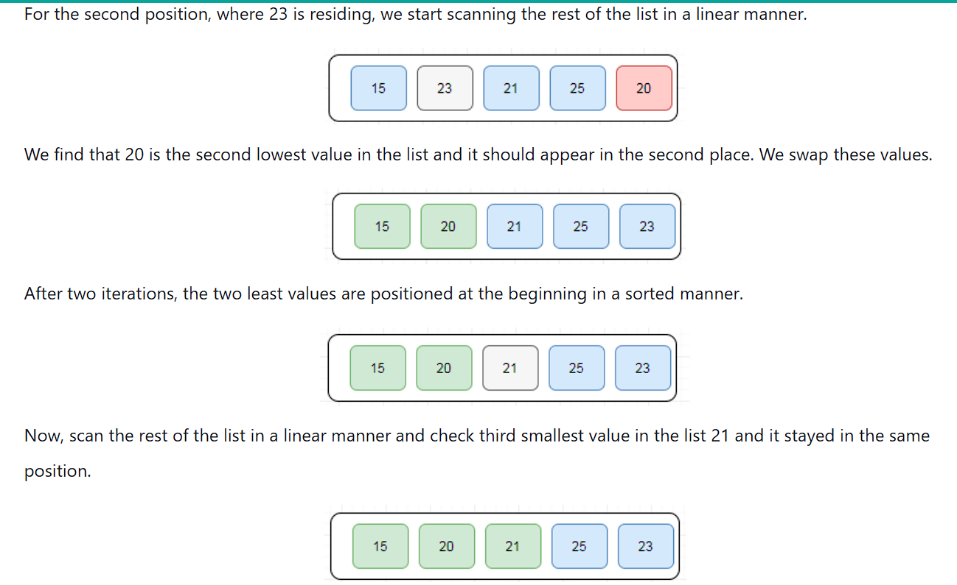

Slide 50
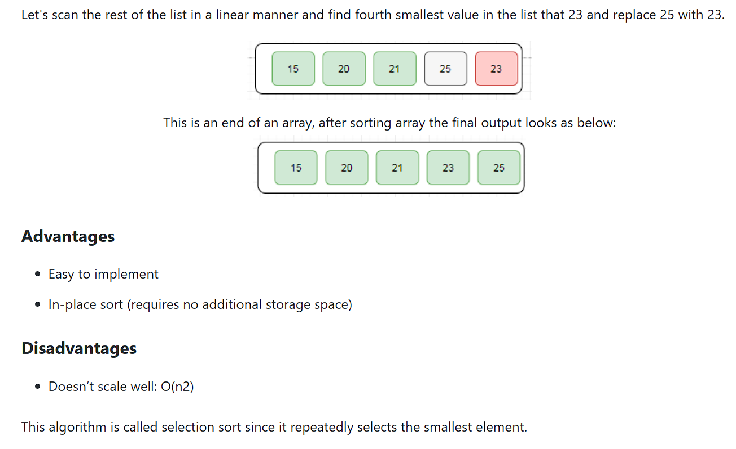

Slide 51
What is Insertion Sort Algorithm?
Insertion sort is a simple and efficient comparison sort. In this algorithm, each iteration removes an element from the input data and inserts it into the correct position in the list is sorted. The choice of the element is removed from the input is random and this process is repeated until all input elements have gone through.
Advantages
Efficient for small data
Adaptive: If the input list is presorted [may not be complete] then insertions sort takes O(n + d), where d is the number of inversions
Practically more efficient than selection and bubble sorts, even though all of them have O(n2) worst case complexity
Stable: Maintains relative order of input data if the keys are same
In-place: It requires only a constant amount O(1) of additional memory space
Online: Insertion sort can sort the list as it receives it

Slide 52
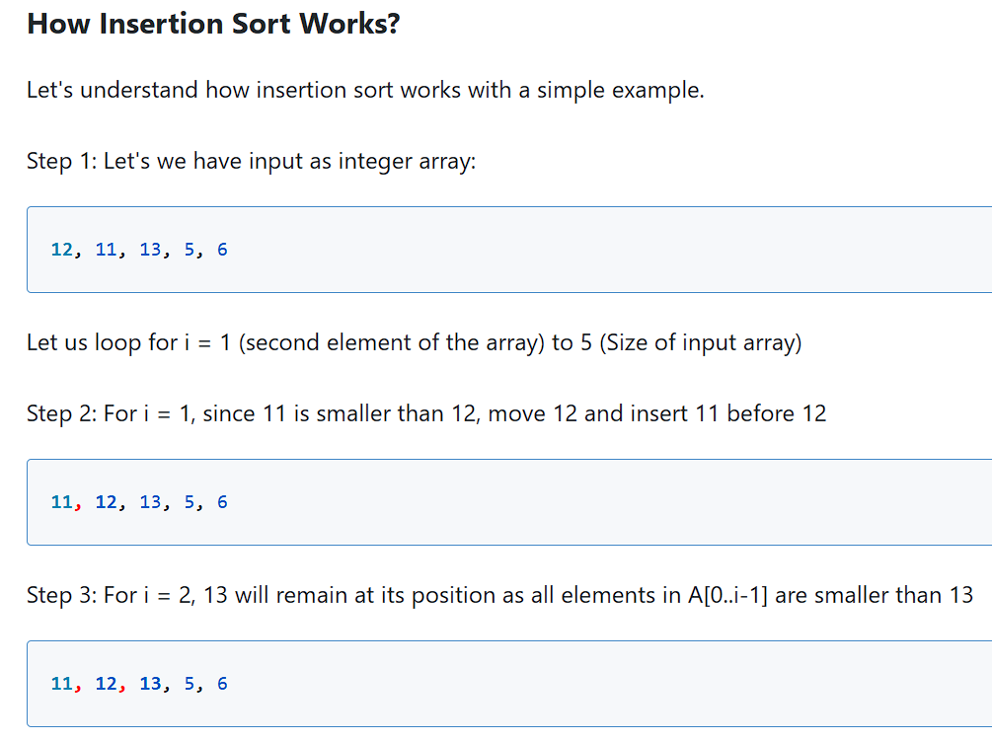

Slide 53
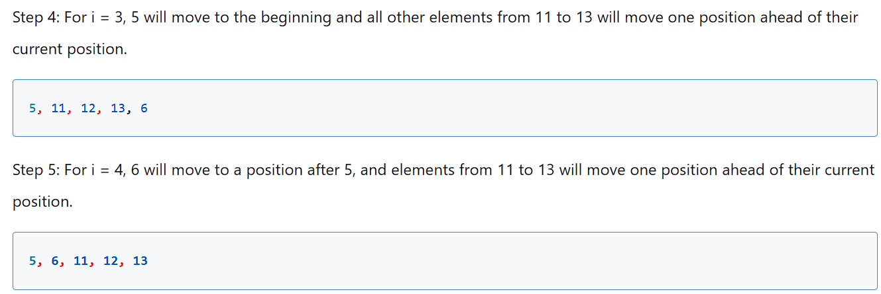

Slide 54
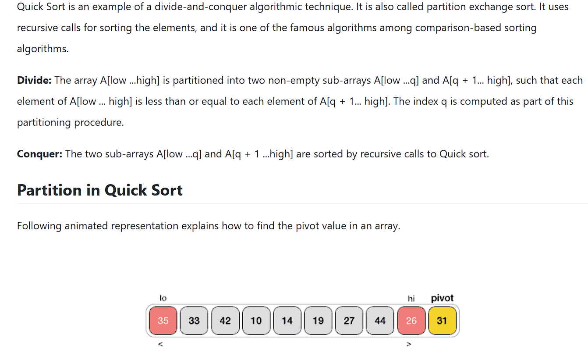
Quick Sort Algorithm

Slide 55
Algorithm
The recursive algorithm consists of four steps:
If there are one or no elements in the array to be sorted, return.
Pick an element in the array to serve as the “pivot” point. (Usually, the left-most element in the array is used.)
Split the array into two parts – one with elements larger than the pivot and the other with elements smaller than the pivot.
Recursively repeat the algorithm for both halves of the original array.

Slide 56
Binary Search Tree (BST)
Binary Search Trees (BST) are essential data structures that allow for efficient insertion, deletion, and search operations. In this blog post, we will walk through the implementation of a BST in Java, focusing on the primary operations: insertion, deletion, and search.
Understanding BST
A BST is a binary tree where every node has the following properties:
The left subtree of a node contains only nodes with keys less than the node's key.
The right subtree of a node contains only nodes with keys greater than the node's key.
Both the left and right subtrees are also BSTs.

Slide 57
Step-by-step Explanation
Node Class:Represents each node in our BST. Contains an integer key and pointers to left and right child nodes.
insert() and insertRec():
These methods help insert a new key into the BST. Using recursion, they traverse the tree to find the correct position and then insert the key.
delete() and deleteRec():
Used to delete a key from the BST. The deleteRec() function uses recursion to find the node to be deleted. If the node has one or no child, it deletes the node. For nodes with two children, it finds the inorder successor (smallest value in the right subtree) and replaces the node's key with this value.
search() and searchRec():
These methods help check if a key exists in the BST. They use recursion to traverse the tree in search of the key.
main Method:
Here, we create a sample BST by inserting multiple keys. Then, we search for a few keys and print the results. Lastly, we delete a key and check if it's successfully removed by searching again.

